Slide 1
Architecture and Design

Slide 2
Main Phases
Development
deployment
Operation
retirement
Maintenance
t

Slide 3
Development
Requirements
definition
Req. inspection
Requirement document
Design
Des. inspection
Design document
Implemen
tation
Code inspection + test
Code
Project management
Configuration management
t

Slide 4
Outline
Process
Properties
Notations
Patterns
Architectural patterns /styles
Design patterns

Slide 5
Architecture
Requirements: what the system should do
Architecture, design: how the system should be built
Architecture, design: same flavour but
Architecture: high level, decide major components and their control and communication framework
Design: lower level, decide internals of each component

Slide 6
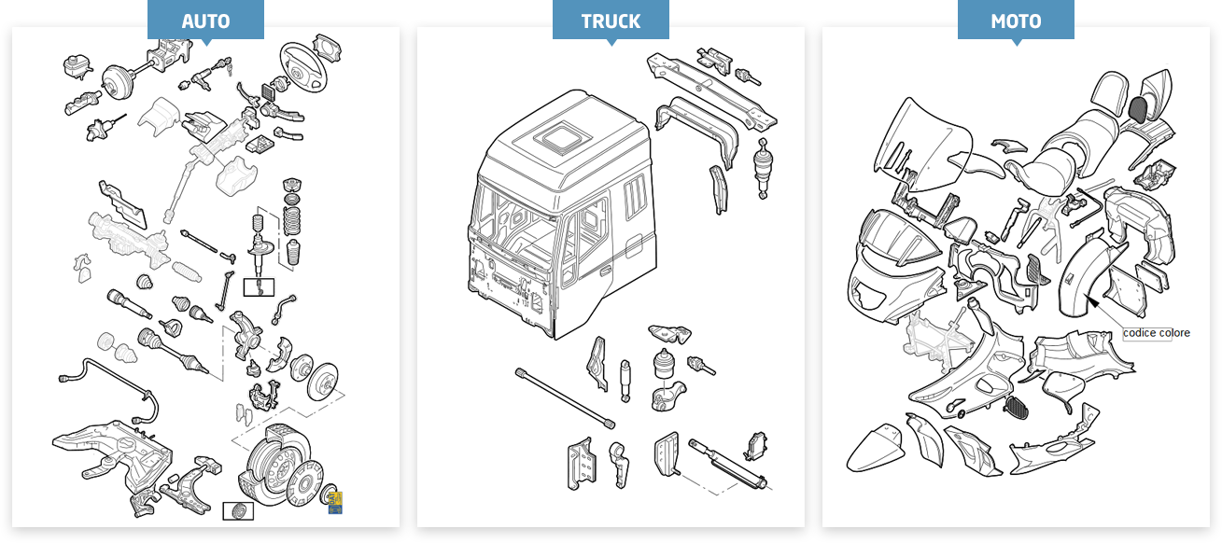
Vehicles

Slide 7
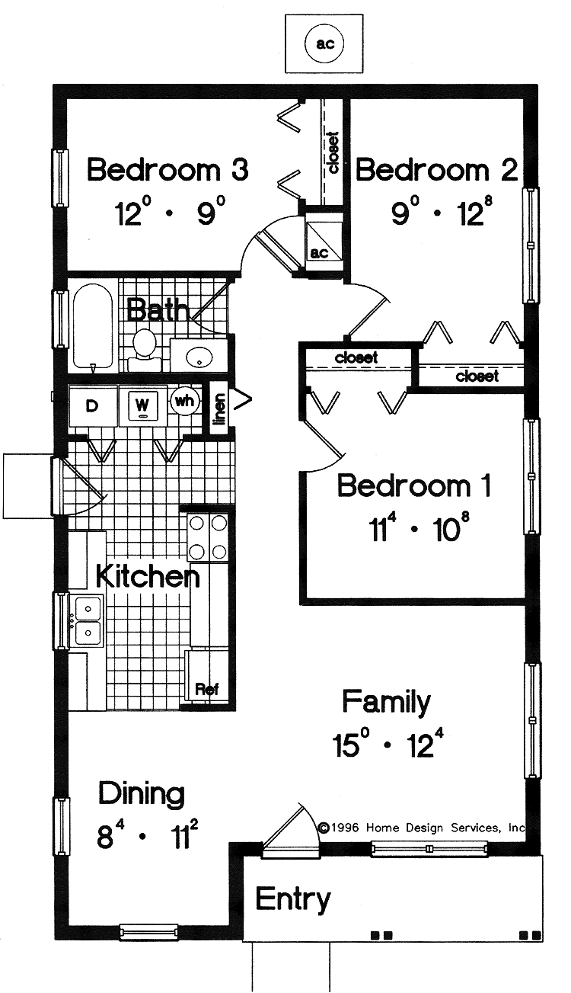
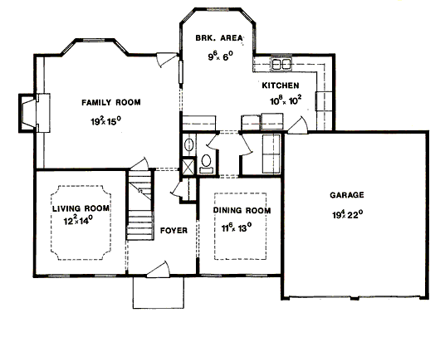
Houses

Slide 8
Architecture, design, why
Most defects come from requirements and design
Essential to define, analyze and evaluate design choices early
If no design is defined, but code is developed immediately, design choices are made implicitly and evaluated late
Doing design allows to make design choices explicit , document and evaluate them

Slide 9
Requirements to design
Given one set of requirements
In general many different designs are possible (design choices)
Cfr. Requirement: mid sized car in price range 10 to 20k
Designs: hundreds of models on the market,
High level design choices
diesel or gas or electric engine
front or rear or all wheel drive
Low level design choices
Color, outer details
With ABS, ESP, .. or not
But not all designs are equal

Slide 10
Requirements to design
A creative process
Driven by skill and experience
Experience formalized in semi formal guidelines
Architectural styles (patterns)
Design patterns

Slide 11
Two process variants
Software only process
(Software) Requirements
(Software) Design
System process
System requirements
System design
Software requirements
Software design

Slide 12
System process
System Requirements engineering
System Requirement
System design
System design
Hardware development (requirement, design, implementation, test)
Software process (requirement, design, implementation, test)
Hardware
Software
System integration, test
System

Slide 13
Software process
System Requirements engineering
System Requirement
System design
System design
Hardware development (requirement, design, implementation, test)
Software process (requirement, design, implementation, test)
Hardware
Software
System integration, test
System

Slide 14
Hw – sw interaction
Software process includes also a part about hardware components and software – hardware allocation (UML Deployment diagram)

Slide 15
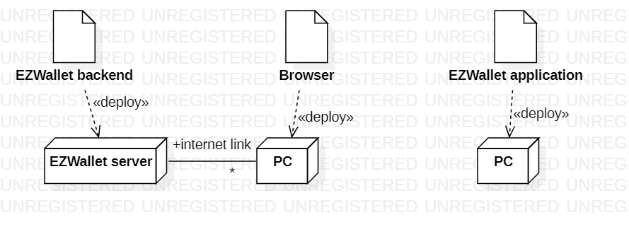
Example
Two options of hw –sw allocation for EzWallet client server single app (multiple concurrent (1 user at a time) users)

Slide 16
Software design
Having defined the hardware context, software design is about:
Defining software modules (functions, classes, packages, modules, ..) and their interactions
so that they satisfy functional + non functional requirements

Slide 17
Process

Slide 18
Design Process
Analysis
Architecture
High level design
Low level design
Formalization
Text, diagrams (UML)
Verification

Slide 19
Process – input and output
Input
Requirement document
(functional requirements
non functional requirements)
Output
Design document
Components + connections
Capable of satisfying functional + non functional requirements

Slide 20
Process - activities
1 Architecture
(about the whole system)
Define high level components and their interactions
Select communication and coordination model
Processes, threads
Messages, (remote) procedure calls, broadcast, blackboard
Use architectural style(s) /pattern(s)

Slide 21
Process - activities
2 Design
2.1 High level (about many classes)
Define classes and their interactions
Use design patterns
2.2 Low level (about one class)

Slide 22
Properties

Slide 23
Properties of a design
Functional properties
Does the design support the functional requirements?
Functional requirements (requirements document)
vs.
functional properties (design)
Non functional properties
Does the design support the non functional requirements?
Non functional requirements (requirements document)
vs.
Non functional properties (design)

Slide 24
Non functional properties
Reliability
Efficiency/performance
Usability
Maintainability
Portability
Safety
Security

Slide 25
Non functional properties
More specific to design
Testability
observability
controllability
Monitorability
Interoperability
Scalability
Deployability
Mobility

Slide 26
Non functional properties
Complexity
Number of components
Number of interactions
KISS: keep it simple, stupid
Coupling (or decoupling)
Degree of dependence between two components
Cohesion
Degree of consistence of functions of a component

Slide 27


Coupling
Walls vs plumbing system
lower higher

Slide 28
Coupling
Controller vs engine
lowest
intermediate
highest

Slide 29
Cohesion
Higher
lower

Slide 30
Non functional properties
Cost
Schedule
Staff skills

Slide 31
Properties – what to do
Performance
Localise critical operations and minimise communications. Use large rather than fine-grain components.
Security
Use a layered architecture with critical assets in the inner layers.
Safety
Localise safety-critical features in a small number of sub-systems.
Availability
Include redundant components and mechanisms for fault tolerance.
Maintainability
Use fine-grain, replaceable components.

Slide 32
Properties
Using large-grain components improves performance but reduces maintainability.
Introducing redundant data improves availability but makes security more difficult.
Localising safety-related features usually means more communication so degraded performance

Slide 33
Properties, trade offs
Not all properties can be satisfied
Design is also about deciding tradeoffs
Ex security (add layers) vs. speed (avoid layers)
Ex. changeability (add abstraction layer to insulate from hardware change) vs. speed (avoid layers)
Possibly, trade offs are decided at requirement time
Ex: requirement: security prevails on speed

Slide 34
Notations for formalization of architecture

Slide 35
Formalizing the architecture
Informal
box and lines
Semiformal
UML diagrams
Structural views
Component, package diagrams
Class diagrams
Deployment diagram
Dynamic views
Sequence diagrams
State charts
Formal ADL (Architecture description languages)
Many, ex C2 (component Connector)

Slide 36
Box and line diagrams
Very abstract - they do not show the nature of component relationships nor the externally visible properties of the sub-systems.
However, useful for communication with stakeholders and for project planning.

Slide 37
Packing robot control system

Slide 38
UML diagrams
Structural view
Component or package diagram for high level view
Class diagram (inside each package or component)
Class description (for each class)

Slide 39
Heating control system
Goal: control temp in house, using sensors in each room, and actuators (open close heating in each room)
Choices – high level
One CPU, one process (no distribution, no concurrency)
Communication and control: procedure call
Layered style (at least partially)
Choices – low level
Observer pattern

Slide 40
Heating control system
Option 1
High level:
One CPU, one process (no distribution, no concurrency)
Communication and control: procedure call
Layered style (at least partially)

Slide 41
Heating control system
Option 2
High level:
One CPU per room, one CPU per house (distribution, concurrency)
Communication and control: http calls (house controller calls rooms)

Slide 42
UML - structural

Slide 43
UML – package diagram

Slide 44
Design
Package GUI

Slide 45
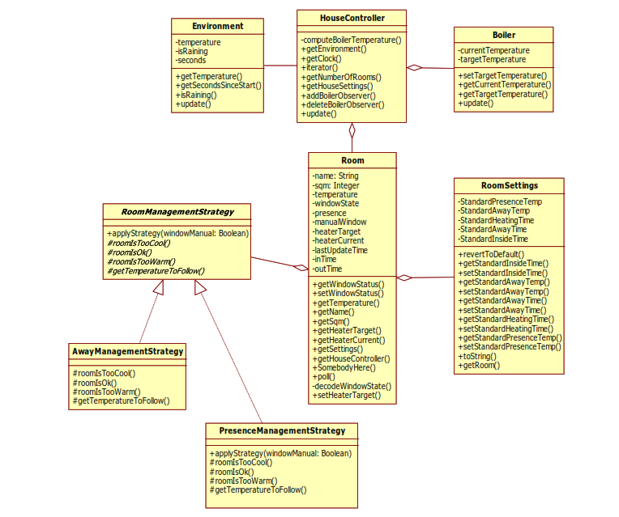
Design
Package HCS

Slide 46
Class (HouseController)
The main class in the heating control system, it integrates the logical model of the various parts of the house and performs the high-level activities.
computeBoilerTemperature()
Computes the desired water temperature in the boiler
getEnvironment()
Navigates to the logical model of the environment
getClock()
Navigates to the Clock
iterator()
Returns an iterator to the contained Rooms
getNumberOfRooms()
Returns the number of rooms
getHouseSettings()
Navigates to the current global settings
update()
Computes the next logical state of the system
addBoilerObserver()
Adds an observer to the Boiler
deleteBoilerObserver()
Removes an object from the list of Boiler observers

Slide 47
Structure and hierarchy
UML helps in presenting structure in an organized (hierarchical) way
Packages in system
Classes in package
Attributes and methods in class
Presentation is sequential, but the definition of such a structure requires several iterations

Slide 48
UML - dynamic
State charts
Sequence diagrams

Slide 49
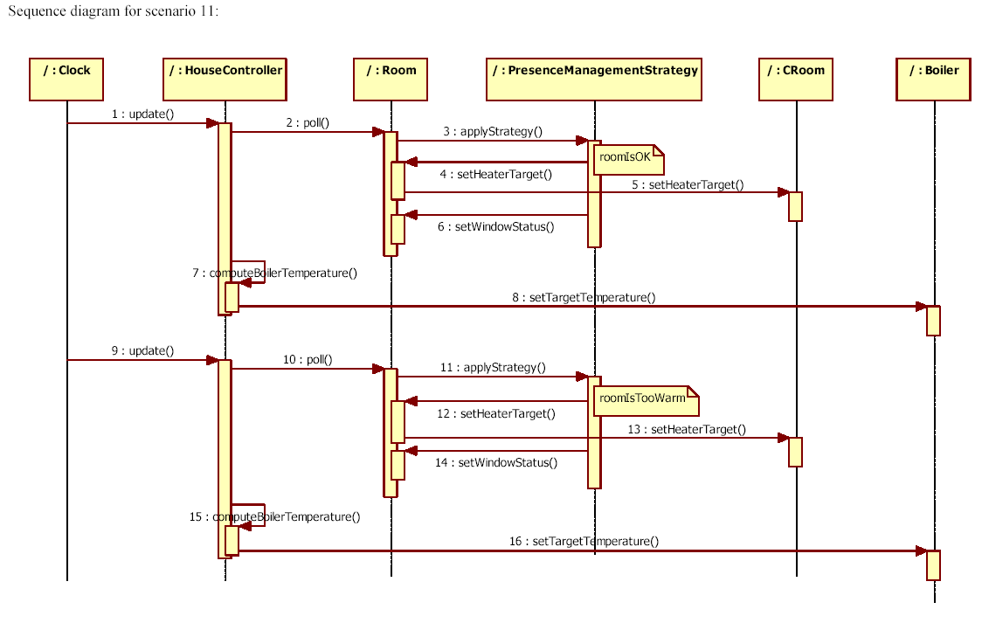
Sequence

Slide 50
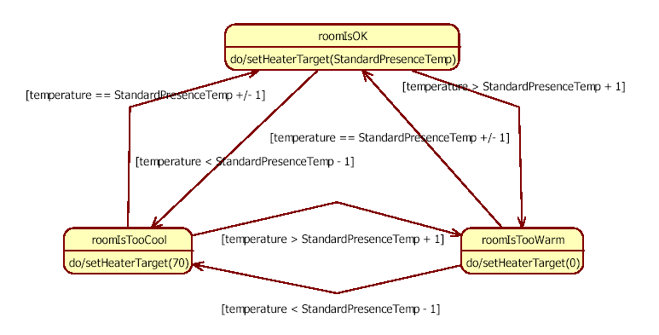
State chart

Slide 51
Patterns

Slide 52
Patterns
Reusable solutions
To recurring problems
In a defined context
Cfr also dominant design in technology management area

Slide 53
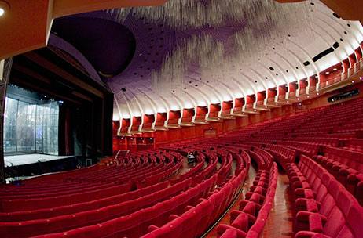
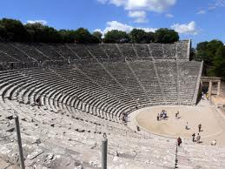
Patterns
Known, working ways of solving a problem

Slide 54
History
Initially proposed by Christopher Alexander
He described patterns for architecture (of buildings)
The pattern is, in short, at the same time a thing, which happens in the world, and the rule which tells us how to create that thing and when we create it. It is both a process and a thing …

Slide 55
Types of Pattern
Architectural Patterns (or styles)
Address system wide structures
Design Patterns
Leverage higher level mechanisms
Idioms
Leverage language specific features

Slide 56
Patterns vs. process
Architectural patterns
1 Architecture
2 Design
2.1 High level
2.2 Low level
Design patterns

Slide 57
Architecture

Slide 58
Process
1 Architecture
2 Design
2.1 High level
2.2 Low level

Slide 59
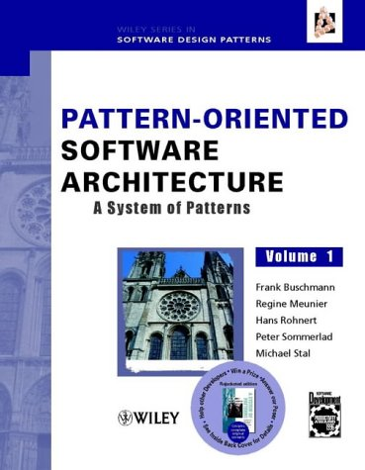
Architectural patterns

Slide 60
Architectural Patterns
Layers
Pipes and filters
Repository
Client server
Broker
MVC
Microkernel
Microservices

Slide 61
A real system is usually influenced by many architectural patterns / styles

Slide 62
The repository style
Sub-systems must exchange data. This may be done in two ways:
Shared data is held in a central database or repository and may be accessed by all sub-systems;
Each sub-system maintains its own database and passes data explicitly to other sub-systems.
When large amounts of data are to be shared, the repository model of sharing is most commonly used.

Slide 63
The repository style
Subsystems exchange data only through the repository, by reading/writing files
No direct exchange through API
The data model is the same for all subsystems
The repository takes care (in the same way for all subsystems) for common services: backup, security, ..

Slide 64
Eclipse and plugins
Eclipse, java editor
Eclipse, JUnit (testing)
Eclipse, Omondo (UML diagrams)
javac
java
Workspace (file system), .java, .class, files

Slide 65
IDE toolset architecture

Slide 66
Repository style characteristics
Advantages
Efficient way to share large amounts of data;
Sub-systems need not be concerned with how data is produced
Centralised management e.g. backup, security
Sharing model is published as the repository schema.
Disadvantages
Sub-systems must agree on a repository data model. Inevitably a compromise;
Data evolution is difficult and expensive;
No scope for specific management policies;
Difficult to distribute efficiently.

Slide 67
Client-server model
Distributed system model which shows how data and processing is distributed across a range of components.
Set of stand-alone servers which provide specific services such as printing, data management, etc.
Set of clients which call on these services.
Network which allows clients to access servers.

Slide 68
Film and picture library

Slide 69
Client-server characteristics
Advantages
Distribution of data is straightforward;
Makes effective use of networked systems. May require cheaper hardware;
Easy to add new servers or upgrade existing servers.
Disadvantages
No shared data model so sub-systems use different data organisation. Data interchange may be inefficient;
Redundant management in each server;
No central register of names and services - it may be hard to find out what servers and services are available.

Slide 70
Abstract machine (layered) model
Used to model the interfacing of sub-systems.
Organises the system into a set of layers (or abstract machines) each of which provide a set of services.
Constraint: layer uses only services from adjacent layer
Advantages
In design: each layer is about a problem (separation of concerns)
In evolution: when a layer interface changes, only the adjacent layer is affected.
Problems
Sometimes artificial to structure systems in this way.

Slide 71
ISO Osi model
7 application
6 presentation
5 session
4 transport
3 network
2 data link
1physical

Slide 72
3 tier architecture
Presentation
Presentation
Application logic
Application logic
Data (drivers)
Data (DBMS)

Slide 73
Version management system

Slide 74
Pipes & Filters
Context
We need to process data streams according to several steps
Problem
Must be possible recombining steps
Non-adjacent steps do not share info
The user storing data after each step may result into errors and garbage

Slide 75
Pipes & Filters
DataSource
+provide input
Pipe
+consume output
+in
+out
DataSink
Filter
Could be implemented simply as a function call

Slide 76
Pipes & Filters Example
Code
Generator
Input
Semantic
Analyser
Scanner
Parser

Slide 77
Pipes & Filter Example
Unix shell commands
Pipe
Pipe
Pipe
grep “Italy” < input.txt | sort > output.txt
Filter
DataSource
Filter
DataSink
Notes:
77

Slide 78
Pipes & Filter Example
DataSource
Input.txt
Filter
Grep
Filter
Sort
DataSink
Output.txt
Notes:
78

Slide 79
Pipes & Filter Example
Input.txt
Rome, Italy
Milan, Italy
Turin, Italy
Paris, France
Marseille, France
Brussels, Belgium
Munich, Germany
Berlin, Germany
Notes:
79

Slide 80
Pipes & Filter Example
grep “Italy” < Input.txt
Rome, Italy
Milan, Italy
Turin, Italy
Paris, France
Marseille, France
Brussels, Belgium
Munich, Germany
Berlin, Germany
Notes:
80

Slide 81
Pipes & Filter Example
| sort > output.txt
Rome, Italy
Milan, Italy
Turin, Italy
Notes:
81

Slide 82
Pipes & Filter Example
Output.txt
Milan, Italy
Rome, Italy
Turin, Italy
Notes:
82

Slide 83
Broker
Context
Environment with distributed and possibly heterogeneous components
Problem
Components should be able to access others
Remotely
Location independently
Components can be changed at run-time
Users should not see too many details
Notes:
Problem is in heterogeneity of communication

Slide 84
Broker
Notes:
Architectural Patterns: Broker (openloop.com)

Slide 85
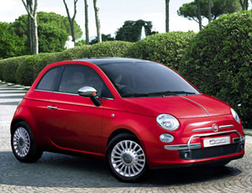
MVC - Problem
Show data to user, manage changes to data
Option1: one class
Option2: MVC pattern

Slide 86
Option1

Slide 87

Option1
Pro
Easy
Con
What if two (three..) pictures?

Slide 89
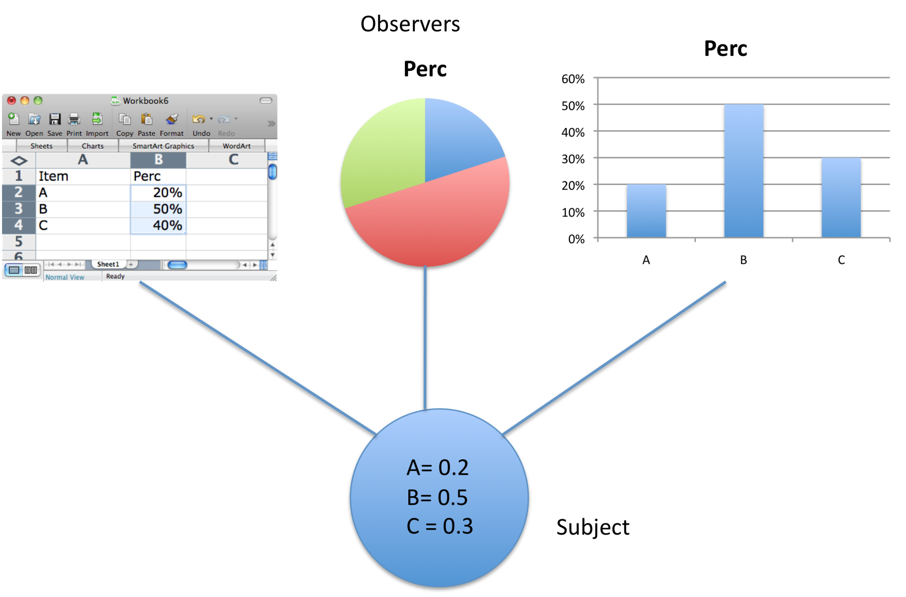
Another case

Slide 90
MVC
Context
Interactive applications with flexible HCI
Problem
The same information is presented in different ways/windows
Windows must present consistent data
Data changes
Goal (product property)
Maintainability, portability

Slide 91
MVC
Model
Responsible to manage state (interfaces with DB or file system)
View
Responsible to render on UI
Controller
Responsible to handle events from UI

Slide 92
MVC

Slide 93
Pros
Separation of responsibilities
Many different views possible
Model and view can evolve independently (maintainability)
Cons
More complexity (less performance)

Slide 94
Execution flow
There is no predefined order of execution
Operations are performed in response to external events (e.g. mouse click)
Event handling is serialized
To execute operations in parallel, threads must be used
Method main in GUIs has the only goal of instantiating the graphical elements

Slide 95
MVC implementations
Given the high level idea
Different implementations happen in different environments
Java
C#
Android
IoS

Slide 96
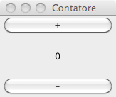
MVC in Java (MV)
Counter

Slide 97
class CounterView implements ActionListener {
private CounterModel model;
private JLabel valueLabel;
private JButton more;
private JButton less;
public CounterView(CounterModel m, JPanel panel) {
model = m;
int value = model.getValue();
panel.add(new JLabel("counter"));
panel.add(valueLabel= new JLabel(Integer.toString(value)));
more = new JButton("more");
less = new JButton("less");
panel.add(more);
panel.add(less);
more.addActionListener(this);
less.addActionListener(this);
}
public void update(){
valueLabel.setText(Integer.toString(model.getValue()));
}
public void actionPerformed(ActionEvent arg0) {
Object o = arg0.getSource();
if (o== more) model.increment();
if (o == less) model.decrement();
update();
}
}

Slide 98
public class CounterModel {
private int value;
public void increment(){ value++;}
public void decrement(){ value--;}
public int getValue(){ return value;}
}
public class MainMV {
public static void main(String[] args) {
JFrame frame = new JFrame();
JPanel panel = new JPanel();
panel.add(new JLabel("here"));
frame.setContentPane(panel);
frame.setSize(300,100);
frame.setVisible(true);
frame.repaint();
CounterModel m = new CounterModel();
CounterView v = new CounterView(m, panel);
}

Slide 99
MVC in Java (MVC)

Slide 100
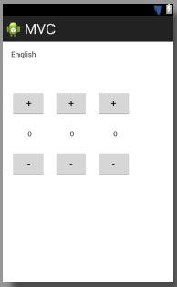
MVC in Android

Slide 101
In heating control system

Slide 102
Microkernel
Context
Several APIs insisting on a common core
Problem
HW and SW evolve continuously and independently
The platform should be:
Portable
Extendable

Slide 103
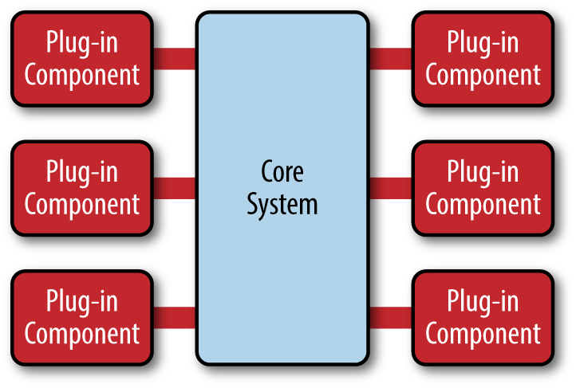
Microkernel
Notes:
Core system + plugins
Permette di aggiungere fz dopo, in modo indip, usando sempre il core
Esempi – eclipse, web browser
eclipse, core e’ editor
web browser, core e’ browser (get data from server and show) – plug in per pdf, per flash, per musica , ..
core tiene anche registro dei plug in (per ogni plugin, nome, servizi, cntratto = data exchanged)

Slide 104
Microservices
Microservice = one executable running in its process (real or virtual machine)
Microservices communicate via http calls, (RESTFul APIs)
Application made of many communicating microservices
Via orchestration
Via choreography

Slide 105
Microservices
Advantages
Each MS could use a different technology stack
Each MS can be released and deployed independently of others
Lower coupling between MSs
Disadvantages
Added complexity
Possibly worse time performance

Slide 106
Microservices
Example (EZShop)
3 MS:
Management of inventory
Management of catalogue
Management of sales and customers

Slide 107
Summary
Architectural patterns deal with overall system structure
They provide a unique metaphor for the system (e.g. pipe and filters)
They address specific domains (e.g. distribution or interaction) and system evolvability

Slide 108
Design

Slide 109
Process
1 Architecture
2 Design
2.1 High level
2.2 Low level

Slide 110
2.1 Design, high level
Definition of classes
From glossary: consider a class for each key entity in glossary
From context diagram:
Consider a class for each actor = physical device or subsystem
Define GUI for each actor = human actor
Consider design patterns

Slide 111
2.2 Design, low level
(inside a class or two)
For each attribute, define type, privacy
For each method, define return type, number and type of parameters, privacy
Define setters, getters (if needed)
For each method, choose algorithms (if needed)
For each relationship with other class, choose implementation
If ‘one’ relationship: reference or key
If ‘many’ relationship: array, map, list

Slide 112
2.2 Design, low level
(inside a class or two)
Decide persistency
No persistence
Yes persistence
Serialization (to file, to network)
To database
Decide framework (hybernate, mybatis, slick …)
On all objects
On part of objects

Slide 113
Relationships– low level design

Slide 114
Relationships – 1-1*

Slide 115
Many many

Slide 116
Example - glossary
System
1
1
1
*
*
*
Course
Student
Exam
-
name
*
*
-
first
1
0
..*
-
data
-
period
-
last
:
:Date
-
instructor
-
grade
:int
:
-
id
+
print
()

Slide 117
Example
System
-
sc
:
List
-
ss
:
List
-
se
:
List
1
1
1
*
*
*
Course
Student
Exam
-
name:String
*
*
-
first:String
1
0
..*
-
data
-
period:int
-
last:String
:
:Date
-
instructor:String
-
grade
:int
:
-
id:String
-
student
-
students:List
-
exams:List
:
Student
+
print
()

Slide 118
Association :1
From Exam towards Course
Exam
Course
*
1
Class Exam { Course c;
setCourse(Course c){
this.c=c;}
}
Class Course {
}

Slide 119
Association :n
From Course towards Exams
Exam
Course
*
1
Class Course {
ArrayList exams;
Course(){ exams = new ArrayList (); }
addExam(Exam e){ exams.add(e);}
}

Slide 120
Association 1:n
Both directions
Exam
Course
*
1
Class Exam {
Course c;
setCourse(Course c){
this.c=c; }
}
Class Course {
ArrayList exams;
Course(){ exams = new ArrayList ();
}
addExam(Exam e){ exams.add(e);}
}

Slide 121
Association 1:1
Both directions
Course
Instructor
1
1
Class Course {
Instructor i;
}
Class Instructor {
Course c;
}

Slide 122
Association n:m
Both directions - option1
Course
*
*
Student
Class Course {
ArrayList students;
Course(){
students = new ArrayList(); }
addStudent(Student s){
students.add(s); }
}
Class Student {
ArrayList courses;
Students(){
courses = new ArrayList();
} addCourse(Course c){
courses.add(c); }
}

Slide 123
Association n:m
Both directions - option 2
Course
*
*
Student
Class Course {
ArrayList<Pair> p;
}
Class Student {
ArrayList<Pair> p;
}
Class Pair {
StudentKey, CourseKey
}
Notes:
P must be the same in all students and courses – same as table of keys in a RDB

Slide 124
Design Patterns (GoF)
Describe the structure of components
Most widespread category of pattern
First category of patterns proposed for software development

Slide 125
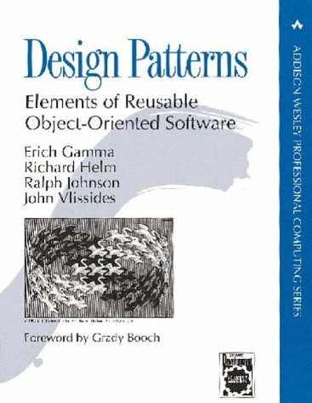
Design Patterns (GoF)
Creational
E.g. Abstract Factory, Singleton
Structural
E.g. Façade, Composite
Behavioral
Class: e.g. Template Method
Object: e.g. Observer

Slide 126
Design patterns
Description of communicating objects and classes that are customized to solve a general design problem in a particular context
A design pattern names, abstracts, and identifies the key aspects of a common design structure that make it useful for creating a reusable object-oriented design

Slide 127
Description
Name and classification
Intent
Also known as
Motivation
Applicability
Structure
Participants
Collaborations
Notes:
Intent What does the design pattern do? What is its rationale and intent? What particular design issue or problem does it address?
Motivation A scenario that illustrates a design problem and how the class and object structures in the pattern solve the problem. The scenario will help you understand the more abstract description of the pattern that follows.
Applicability What are the situations in which the design pattern can be applied? What are examples of poor designs that the pattern can address? How can you recognize these situations
Structure A graphical representation of the classes in the pattern also use interaction diagrams
Participants The classes and/or objects participating in the design pattern and their responsibilities.
Collaborations How participants collaborate to carry out their responsibilities.

Slide 128
Description
Consequences
Implementation
Sample code
Known uses
Related patterns
Notes:
Consequences How does the pattern support its objectives? What are the trade-offs and results of using the pattern? What aspect of system structure does it let you vary independently?
Implementation What pitfalls, hints, or techniques should you be aware of when implementing the pattern? Are there language-specific issues?
Sample Code Code fragments that illustrate how you might implement the pattern in C++ or Smalltalk.
Known Uses Examples of the pattern found in real systems. We include at least two examples from different domains.
Related Patterns What design patterns are closely related to this one? What are the important differences? With which other patterns should this one be used?

Slide 129
Classification
Purpose
Creational
Structural
Behavioral
Scope
Class
Object

Slide 130
Classification
 |  | Purpose
 |  | Creational | Structural | Behavioral
Scope | Class | 1 | 1 | 2
 | Object | 4 | 6 | 10

Slide 131
Pattern selection
Consider how patterns solve problems
Scan intent sections
Study how pattern interrelate
Study patterns of like purpose
Examine a cause of redesign
Consider what should be variable in your design

Slide 132
Using a pattern
Read through the pattern
Go back and study
Structure
Participants
Collaborations
Look at the sample code

Slide 133
Using a pattern
Choose names for participants
Meaningful in the application context
Define the classes
Choose operation names
Application specific
Implement operations

Slide 134
Creational patterns
Factory Method
Abstract Factory
Builder
Prototype
Singleton

Slide 135
Abstract Factory
Context
A family of related classes can have different implementation details
Problem
The client should not know anything about which variant they are using / creating

Slide 136
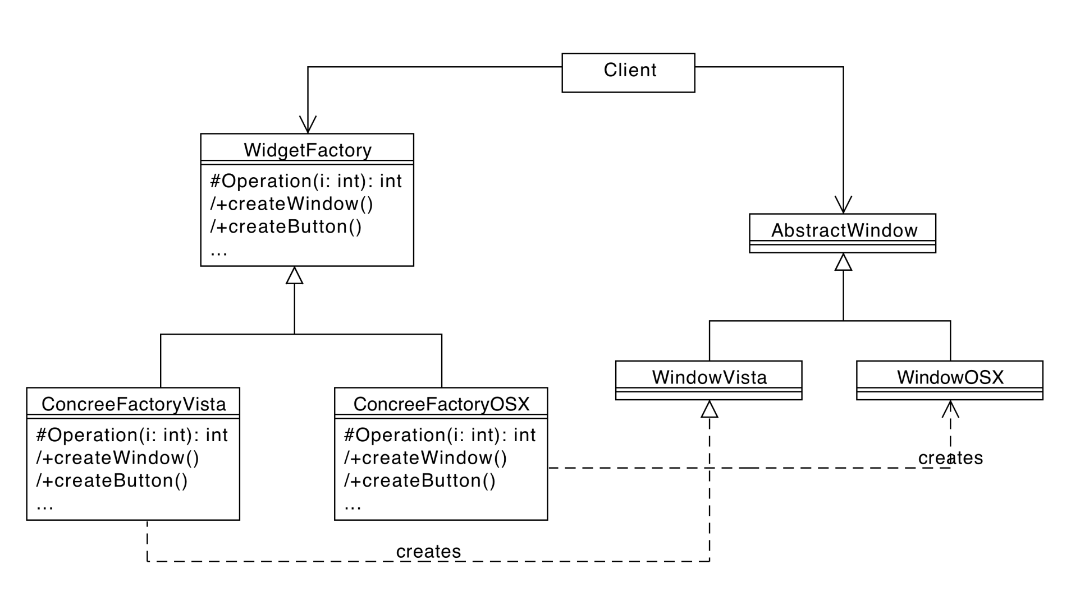
Abstract Factory Example

Slide 137

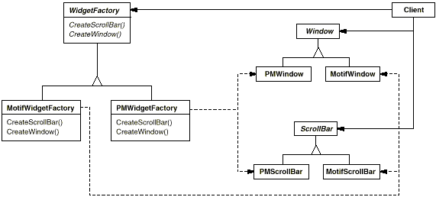
Abstract Factory

Slide 138
Singleton
Context:
A class represents a concept that requires a single instance
Problem:
Clients could use this class in an inappropriate way

Slide 139
Singleton
Count how many objects in my program
Class ObjectCounter {
static boolean new = false;
ObjectCounter () { if new == false then }
static counter = 0; new = true}
else donothing
add() {counter++;}
sub() {counter--;} }
Client : ObjectCounter oc = new ObjectCounter();
.... Oc.add(); ... Oc.sub
ObjectCounter oc2 = new ObjectCounter();
Notes:
Contare istanze di classe

Slide 140
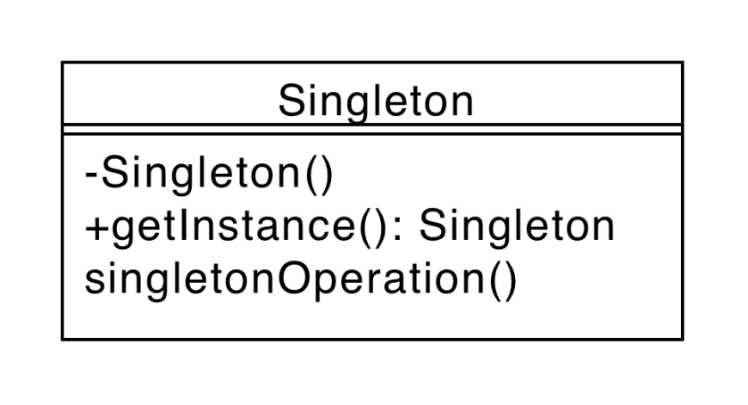
Singleton
Singleton class
Instantiation static method
private Singleton() { }
private static Singleton instance;
public static Singleton getInstance(){
if(instance==null)
instance = new Singleton();
return instance;
}
Notes:
Avere una sola istanza
Costrutt privato – solo getinstance

Slide 141
Structural patterns
Structural patterns are concerned with how classes and objects are composed to form larger structures.

Slide 142
GoF structural patterns
Adapter
Bridge
Composite
Decorator
Facade
Flyweight
Proxy

Slide 143
Adapter
Context:
A class provides the required features but its interface is not the one required
Problem:
How is it possible to integrate the class without modifying it
Its source code could be not available
It is already used as it is somewhere else

Slide 144
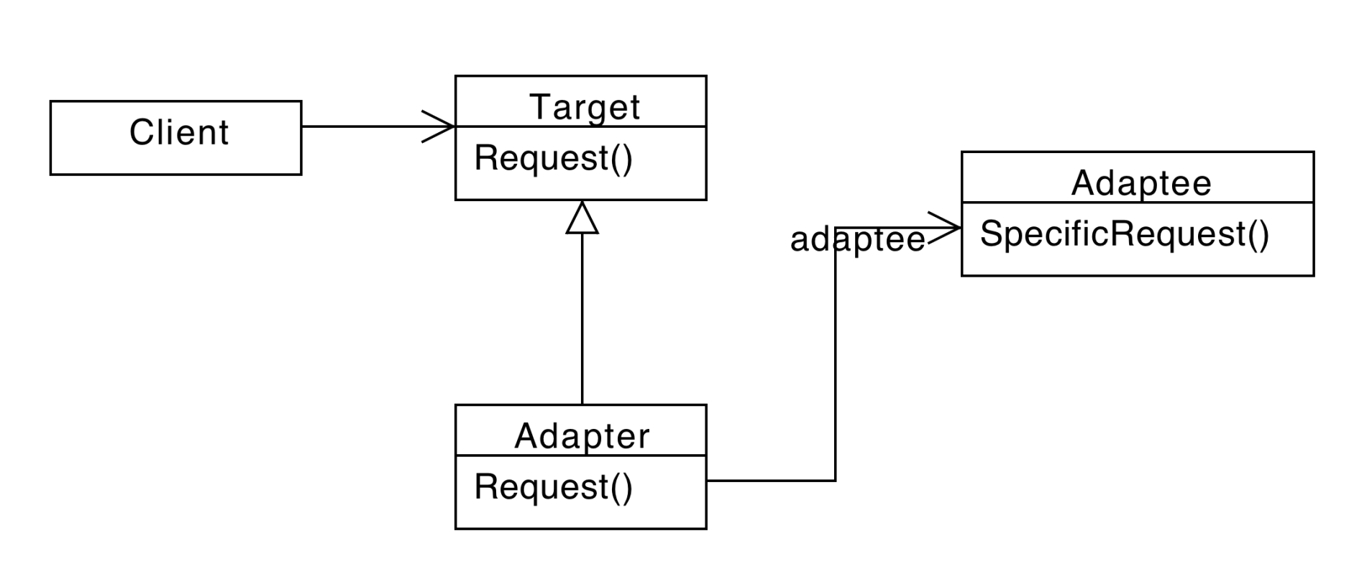
Adapter

Slide 145
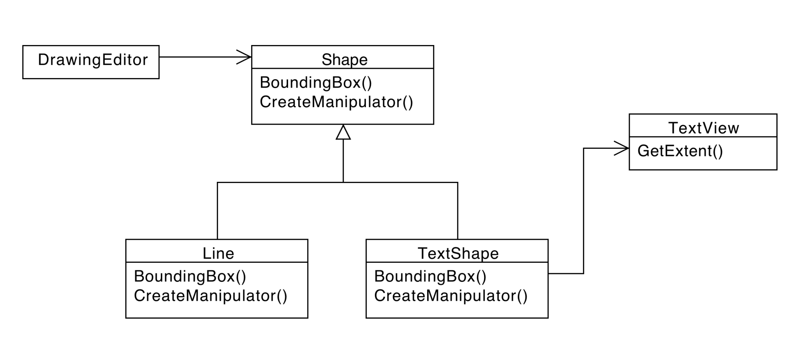
Adapter example

Slide 146
Java Listener Adapter
In Java GUI events are handled by Listeners
Listener classes need to implement Listener interfaces
Include several methods
They all should be implemented

Slide 147
Java Listener Adapter
class MyListener{
public void KeyPressed(..){}
public void KeyReleased(..){
// … handle event
}
public void KeyTyped(..){} }
class MyListener{
public void KeyReleased(..){
// … handle event
}
}

Slide 148
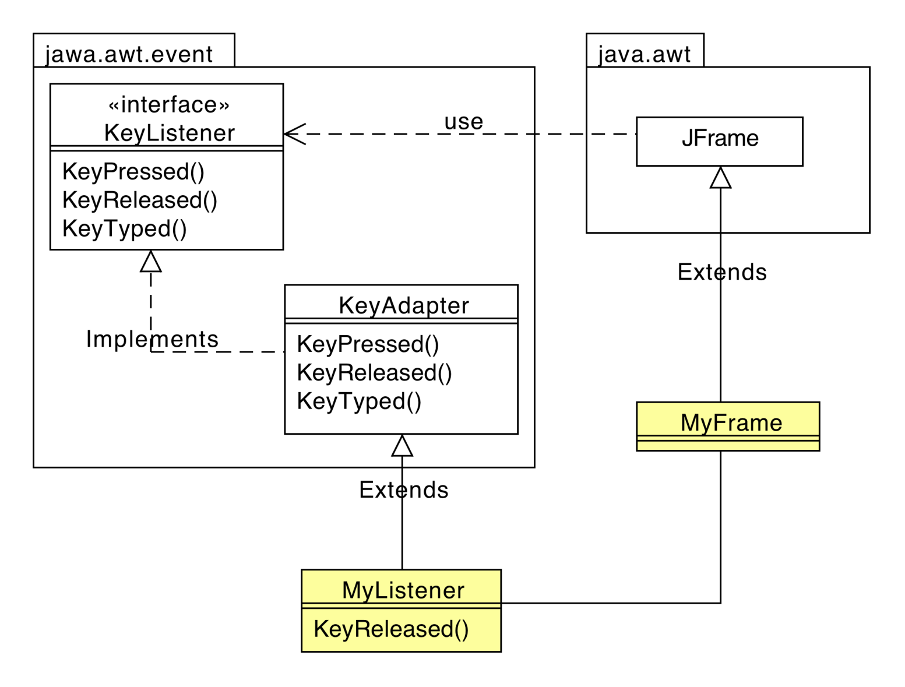
Java Listener Adapter

Slide 149
Structural Class Patterns
Adapter pattern
Inheritance plays a fundamental role
Only example of structural class pattern

Slide 150
Composite
Context:
You need to represent part-whole hierarchies of objects
Problem
Clients are complex
Difference between composition objects and individual objects.

Slide 151
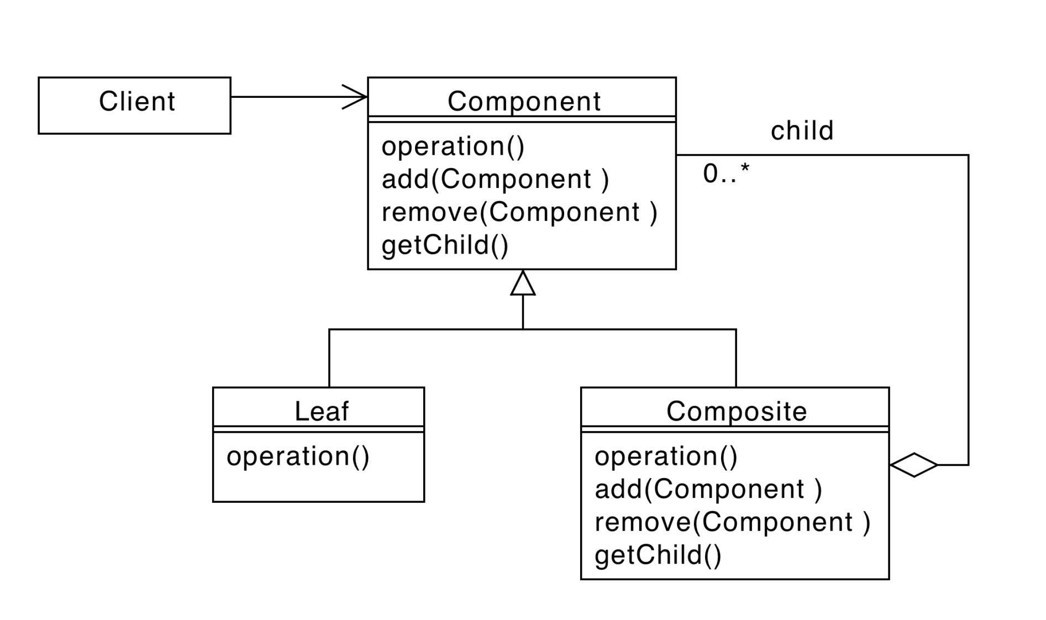
Composite
Notes:
Part of hierarchy
All are treated the same way

Slide 152
Example: widgets in GUI

Slide 153
Composite Example
Arithmetic expressions representation
Operators
Operands
A+ B * (A + B)
Evaluation of expressions

Slide 154
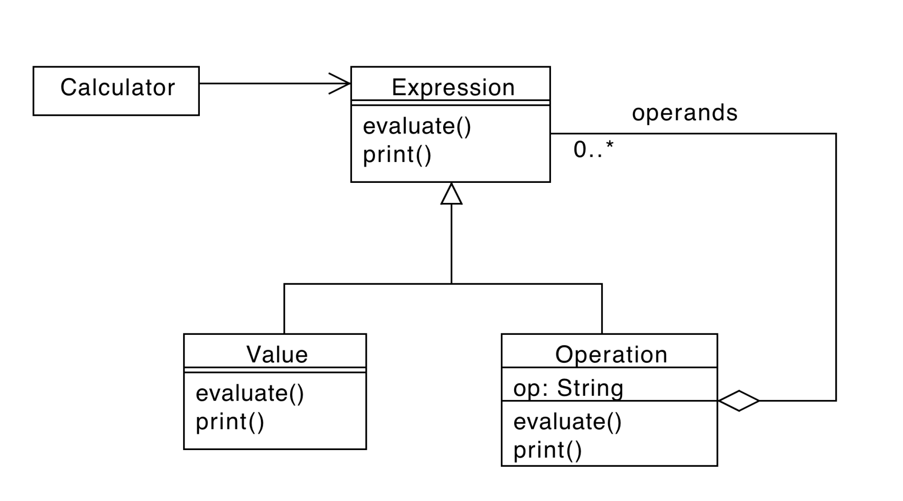
Composite Example

Slide 155
Composite Example
abstract class Expression {
public abstract int evaluate();
public abstract String print();
}

Slide 156
Composite Example
class Value {
private int value;
public Value(int v){
value = v;
}
public int evaluate(){
return value;
}
public String print(){
return new String(value);
}
}

Slide 157
Composite Example
Class Operation {
private char op; // +, -, *, /
private Expression left, right
public Operation(char op,
Expression l, Expression r){
this.op = op;
left = l;
right= r;
}
…

Slide 158
Composite Example
class Operation {
…
public evaluate(){
switch(op){
case ‘+’: return
left.evaluate() +
right.evaluate();
break;
…
}
}
…

Slide 159
Composite Example
class Operation {
…
public print(){
return left.print() + op + right.print();
}
}

Slide 160
Facade
Context
A functionality is provided by a complex group of classes (interfaces, associations, etc.)
Problem
How is it possible to use the classes without being exposed to the details

Slide 161
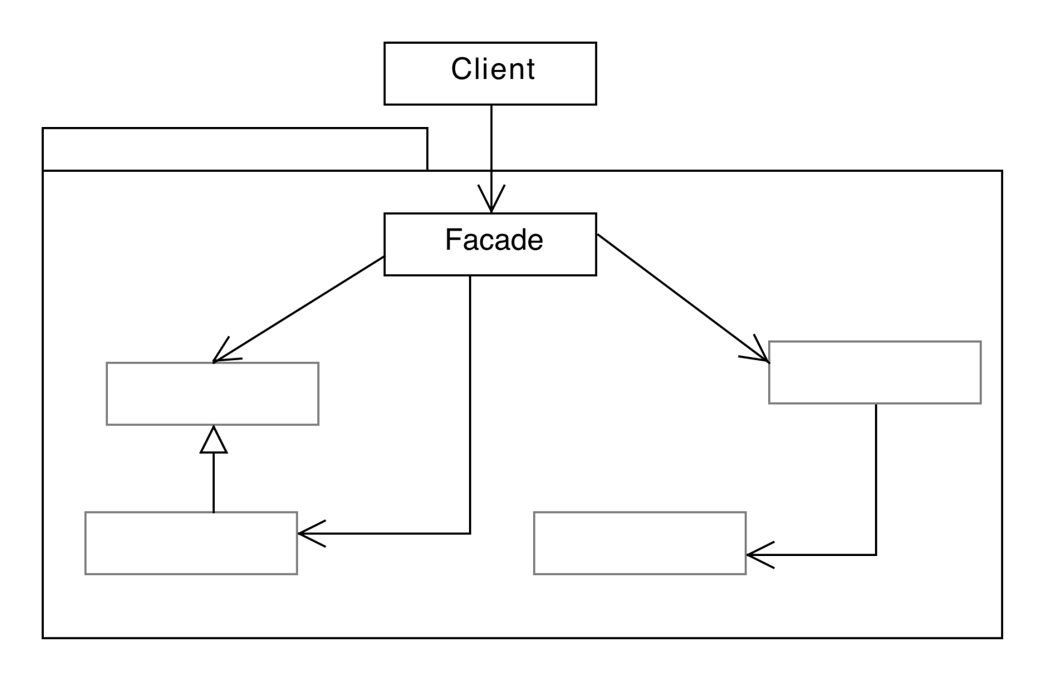
Façade

Slide 162
Package
public Class A { public void method1();}
public Class B { public void method2();}
public Class C { void method3();}

Slide 163
Without facade
Client
A a; B b; C c;
a.method1();
b.method2();
c.method3();

Slide 164
With facade
Package
public class Facade {
void method1( A.method1)}
void method2( B.method2)}
void method3( C.method3)}
}
Client
Facade.method1(); Facade.method2();
Facade.method3();

Slide 165
Behavioral patterns
Behavioral patterns are concerned with algorithms and the assignment of responsibilities between objects.
Not just patterns of objects or classes but also the patterns of communication.
Complex control flow that's difficult to follow at run-time.
Shift focus away from flow of control to let concentrate just on the way objects are interconnected.

Slide 166
GoF behavioral patterns
Object-level
Chain of Responsibility
Command
Iterator
Mediator
Memento
Observer
State
Strategy
Visitor
Class-level
Template Method
Interpreter

Slide 167
Observer
Context:
The change in one object may influence one or more other objects
Problem
High coupling
Number and type of objects to be notified may not be known in advance

Slide 168
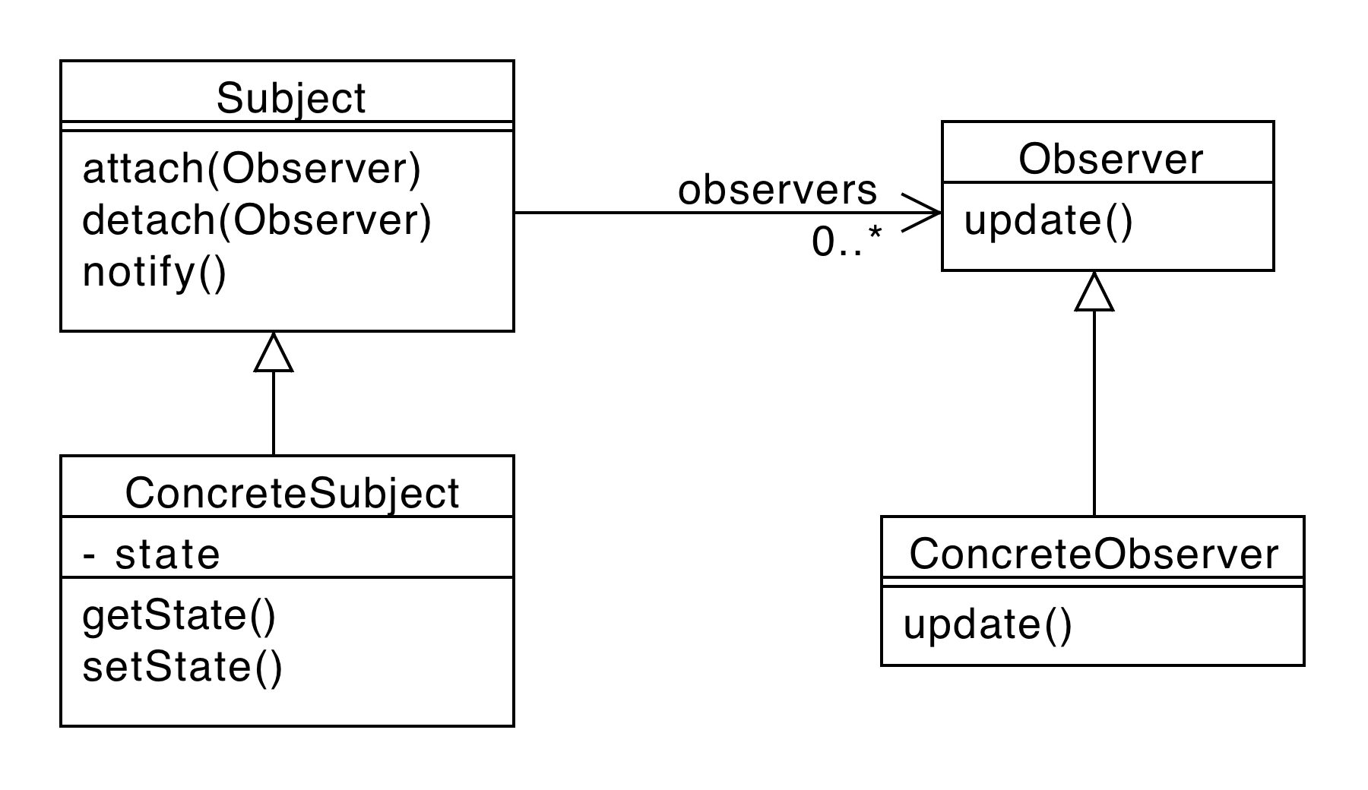
Observer
Observable
Observable

Slide 169
Observer - Consequences
+Abstract coupling between Observable and Observer
+Support for broadcast communication
-Unanticipated updates

Slide 170
Java Observer-Observable
class Observable{
void addObserver(..){}
void deleteObserver(..){}
void deleteObservers(){}
int countObservers() {}
void setChanged() {}
void clearChanged() {}
boolean hasChanged() {}
void notifyObservers() {}
void notifyObservers(..) {}
}

Slide 171
Observer Example
observable

Slide 172
Strategy
Context
Many classes or algorithms have a stable core and several behavioral variations
Problem
Several different implementations are needed.
Multiple conditional constructs tangle the code.

Slide 173
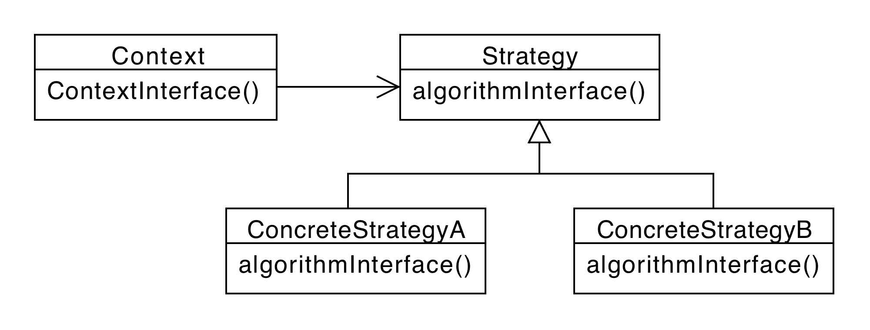
Strategy

Slide 174
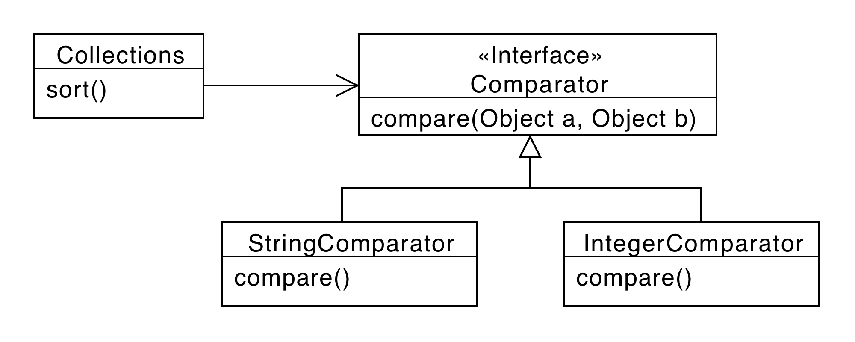
Strategy Example

Slide 175
Consequences
+ Avoid conditional statements
+ Algorithms may be organized in families
+ Choice of implementations
+ Run-time binding
- Clients must be aware of different strategies
- Communication overhead
- Increased number of objects

Slide 176
Analysis with Patterns
Process:
Find out what patterns are used
Find out what the role assignments are
Find out how functionalities are implemented by means of patterns
…use this knowledge

Slide 177
Example
Roles

Slide 178
Example
A program that handles symbolic algebraic expression manipulation
Functionality:
Definition of expressions
Evaluation of expressions

Slide 179
Example - Architecture

Slide 180
Expression Representation
3 + x
+
3
x

Slide 181
Expression Definition
Constant three=new Constant(3);
Variable x = new Variable(“x”);
Expression e = new Sum(three,x);
//…
float result = e.evaluate();
//…

Slide 182
Roles Assignments

Slide 183
Exercise
A program that calculates statistics for questionnaire replies.
Data can be either in:
An XML file
A relational database
All the statistics manipulations are independent from the medium

Slide 184
Exercise - Architecture
SQL
XML

Slide 185
Exercise - Data Access

Slide 186
Exercise - Questionnaire
public abstract class Questionnaire{
private static Questionnaire single;
public static Questionnaire getQuestionnaire(){
if(single!=null) return single;
single = new something();
return single;
}
public QuestReader createReader();
}
Questionnaire q = Questionnaire.getQuestionnaire();
QuestReader qread = q.createReader();
//…
q.read();

Slide 187
Exercise
What patterns are used in this example?
What are the role assignments?
What purpose do(es) the pattern(s) serve?

Slide 188
Verification

Slide 189
Verification
Functional requirements
Traceability matrix
Scenarios executed on architecture
Inspection
Non functional requirements
Performance
Scenarios enriched with time model
(Inspection)

Slide 190
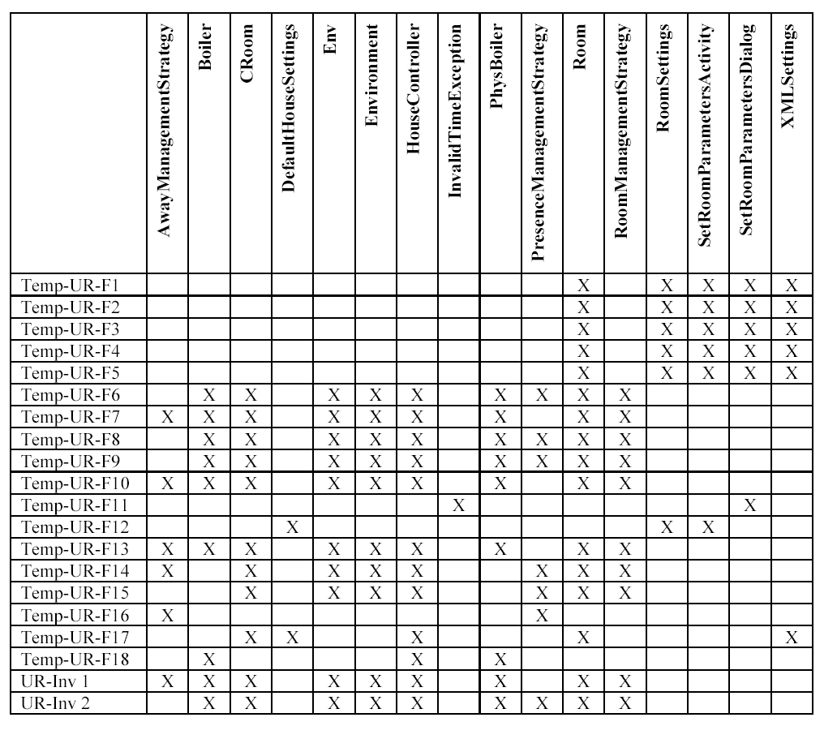
Traceability matrix

Slide 191
Traceability matrix
Each functional requirement (from requirements document) must be supported by at least one function in one class in the software design
The more complex the requirement, the more member functions needed

Slide 192
Scenarios
Each scenario (from requirements document) must be feasible
It is possible to define a sequence of calls to member functions of classes in the software design that matches the scenario

Slide 193
Object
Actor
: Professor
:System
:course
:Student
selectCourse (subjectName)
print()
lifeline
print()
{ for all students
subscribed
to course}

Slide 194
Key points
Architecture
defining high level components and their control, communication model
Tools: UML or ADL models, structural and dynamic
Styles: Layered, client server (2 tier, 3 tier), peer to peer, shared repository
Design
Define internals of components
Tools: UML models
Design patterns

Slide 195
Key points
Verification
inspections
Architecture can satisfy functional properties (as defined in requirements doc)?
Traceability matrixes
Scenario execution
Architecture can satisfy non functional requirements?
Enriched scenarios
build prototype

Slide 196
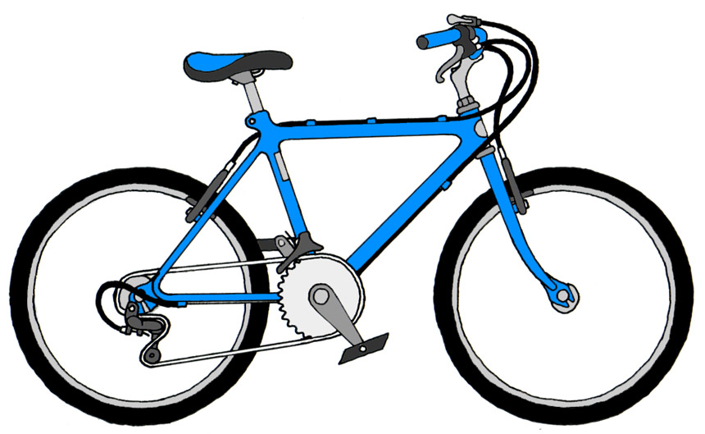
Bicycles ..

Slide 197
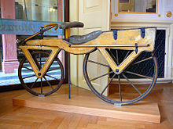
Draisine
1820
Front wheel steering
Foot powered

Slide 198
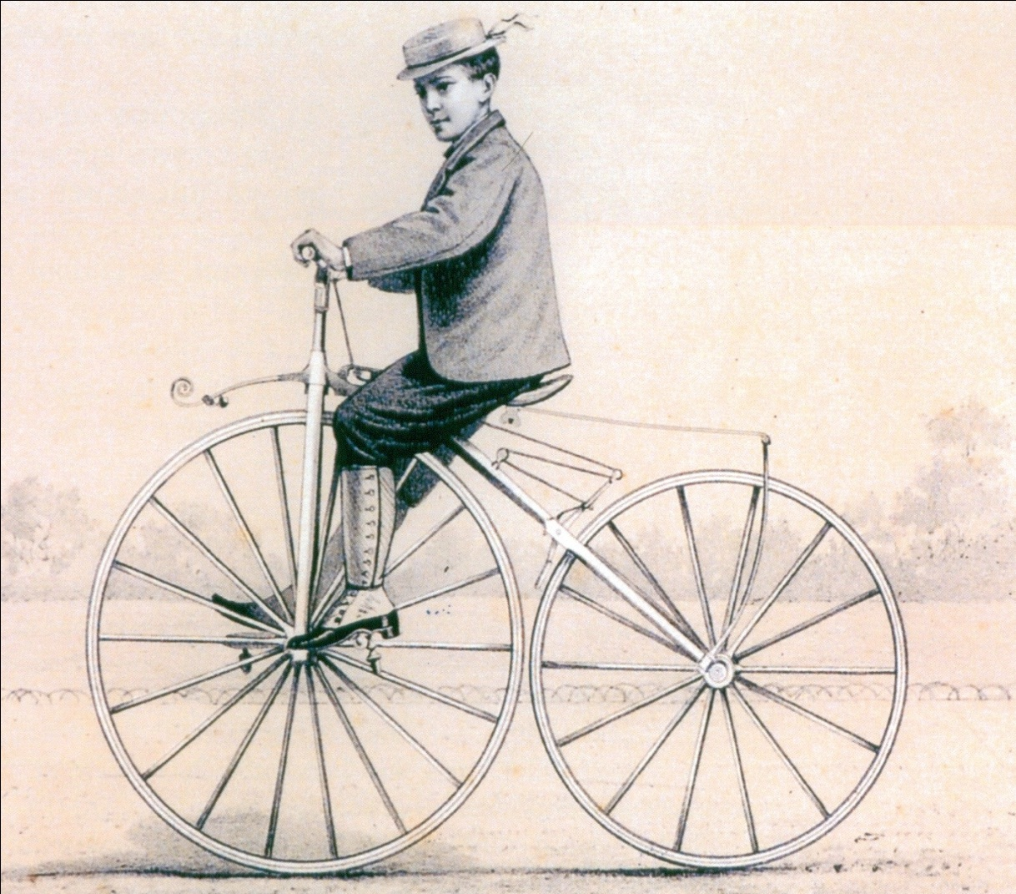
Velocipede
1860
Front wheel steering
Crank pedal on front wheel

Slide 199
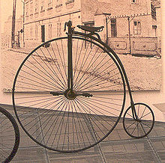
Penny farthing
1870
Larger front wheel
More speed
More comfort
unstable

Slide 200
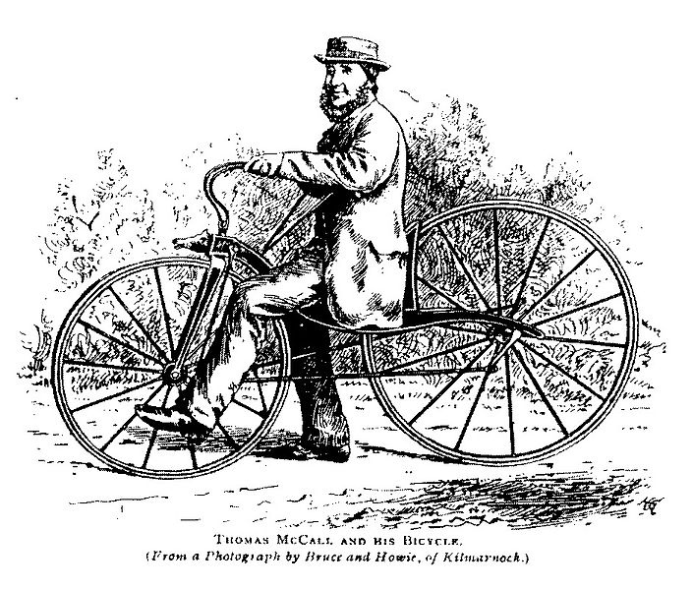
Dwarf ordinary
Smaller front wheel, seat backwards
More stable, less speed, less confort

Slide 201
And ..
1870, chain drive
Solves problem of steering and pedaling on front wheel
Pedals in middle, power to rear wheel
1885, seat tube (diamond frame)
1888, pneumatic tire (Dunlop)
Comfort
1890
Rear freewheel (coasting)
1905
Derailleur gears

Slide 202
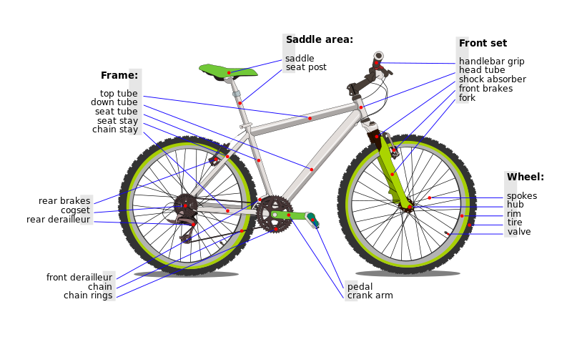
Dominant design

Slide 203
Dominant design
Requires time to develop and be commonly shared in the domain
Requires specific components
Leads to specialized companies / roles
Company to design/develop tyres
Company to design/develop chains
Etc..

Slide 204
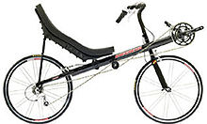
Other designs

Slide 205
Requirements - bike
Functional requirements
transport one person from place to place
Steer
accelerate
brake
Non functional requirements
Efficiency : speed from 10 km/h to 50 km/h
(Speed from 10 km/h to 150 km/h)
Efficiency : weight between 10 and 15kg
Efficiency: reasonable torque to start: < 40Nmeters
Usability: out of 50 average users, at least 60% of them can use it within 10 minutes
Only human power (no engines)
Safety (no harm to driver)
Security (difficult to steal)
Cost (between 100 and 200 euro)

Slide 206
Design vs requirements
 | Draisine | Velocipede | Penny farthing | Another design | Dominant design
Transport one person | y | Y | Y | Y | Y
Eff – speed | < 10kmh | Y | Y | Y | Y
Eff – torque at start | Y | N | N | Y | Y
Eff – weight | y | Y | Y | Y | y
Human power | y | Y | Y | Y | Y
safety | Driver less high | Driver vey high | Driver even higher | Y | Y
Reduce speed | With feet on road | Applying negative force to pedal | Applying negative force to pedal | Y | y brakes

